Slide 1
INDONESIA WEATHER
ETL & Visualization
Presented by Raden Bimo

Slide 2
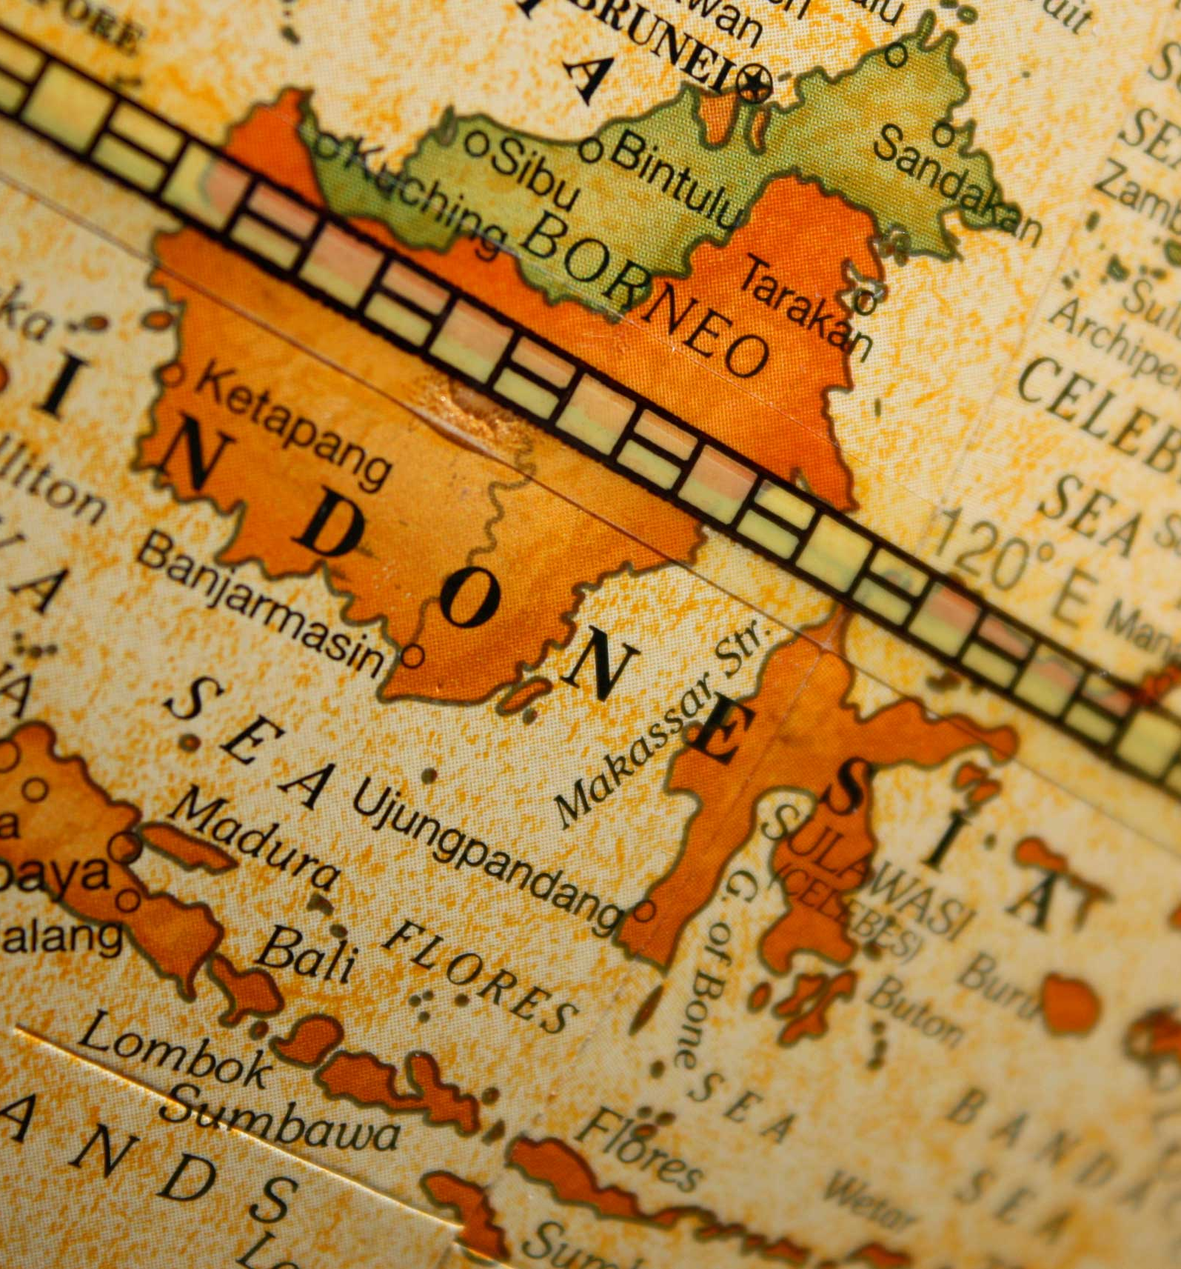
PROBLEM STATEMENT
Accurate weather prediction and visualization are crucial in Indonesia due to its diverse geography.
In the current era of rapid technological advancements, AI has emerged as a powerful tool solve many problem we have.
The objective of this project is to implement an ETL process, enabling weather prediction and visualization in Indonesia.

Slide 3
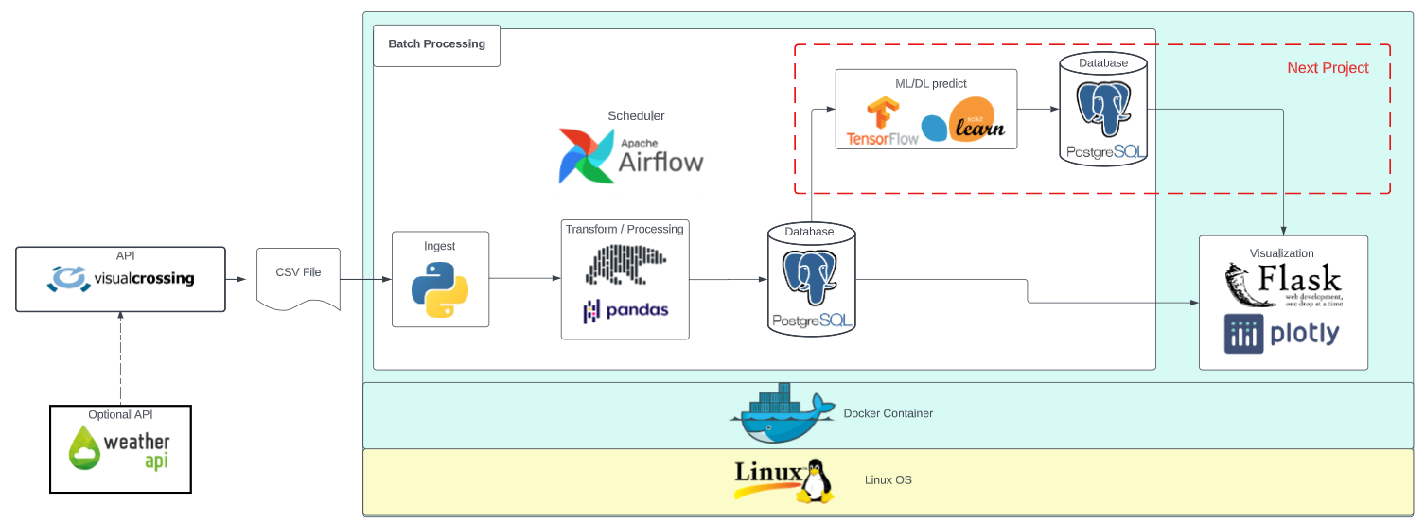
Data Pipeline
The project run very straight forward, It begins by ingesting CSV data using the Airflow Hook. Then transformed using pandas and polars libraries before being loaded into a database. Finally, the visualization using Flask and Dash with plotly integration. However, it is important to note that the project is still in the development phase. The next step involves the implementation of the AI component.

Slide 4
01
02
04
Data
Airflow
App
Stack
03
Database
The API to get the data from Visualcrossing
Airflow DAG and setup to ETL data
Database structure
App configuration

Slide 5

Data from API Visualcrossing
O1
https://weather.visualcrossing.com/VisualCrossingWebServices/rest/services/timeline/{city}/{start_date}/{end_date}?unitGroup={us}&include={range_data}&key={api_key}&contentType={file_type}
The website already provides API results in a CSV file format, making the task much easier. The API breakdown includes the following parameters:
city: is the address, partial address or latitude,longitude location for which to retrieve weather data
start_date: start date shown (yyyy-MM-dd)
end_date: final date shown (yyyy-MM-dd)
range_data: aggregate the data will retieve (hour, day, month)
api_key: key given to an account from website to retrieve the data
File_type: The type of the file data retrieved

Slide 6
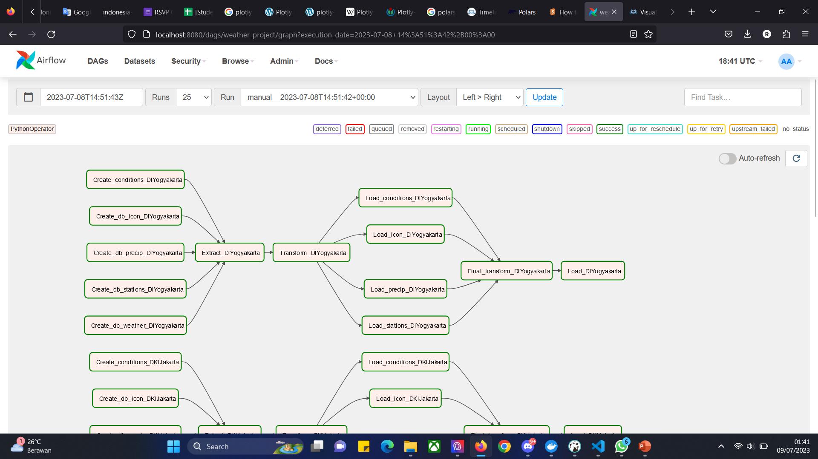
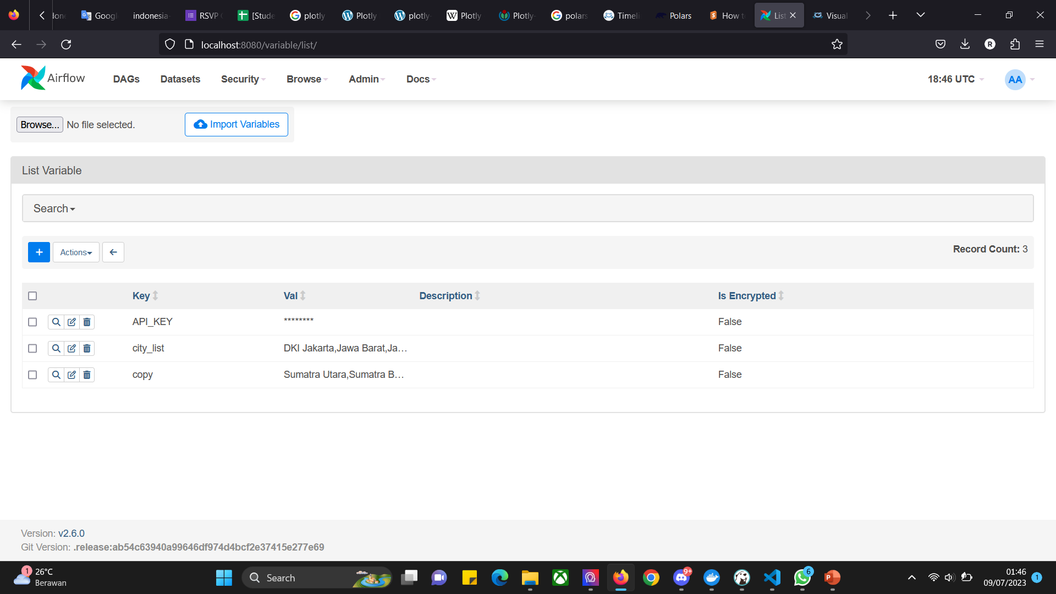
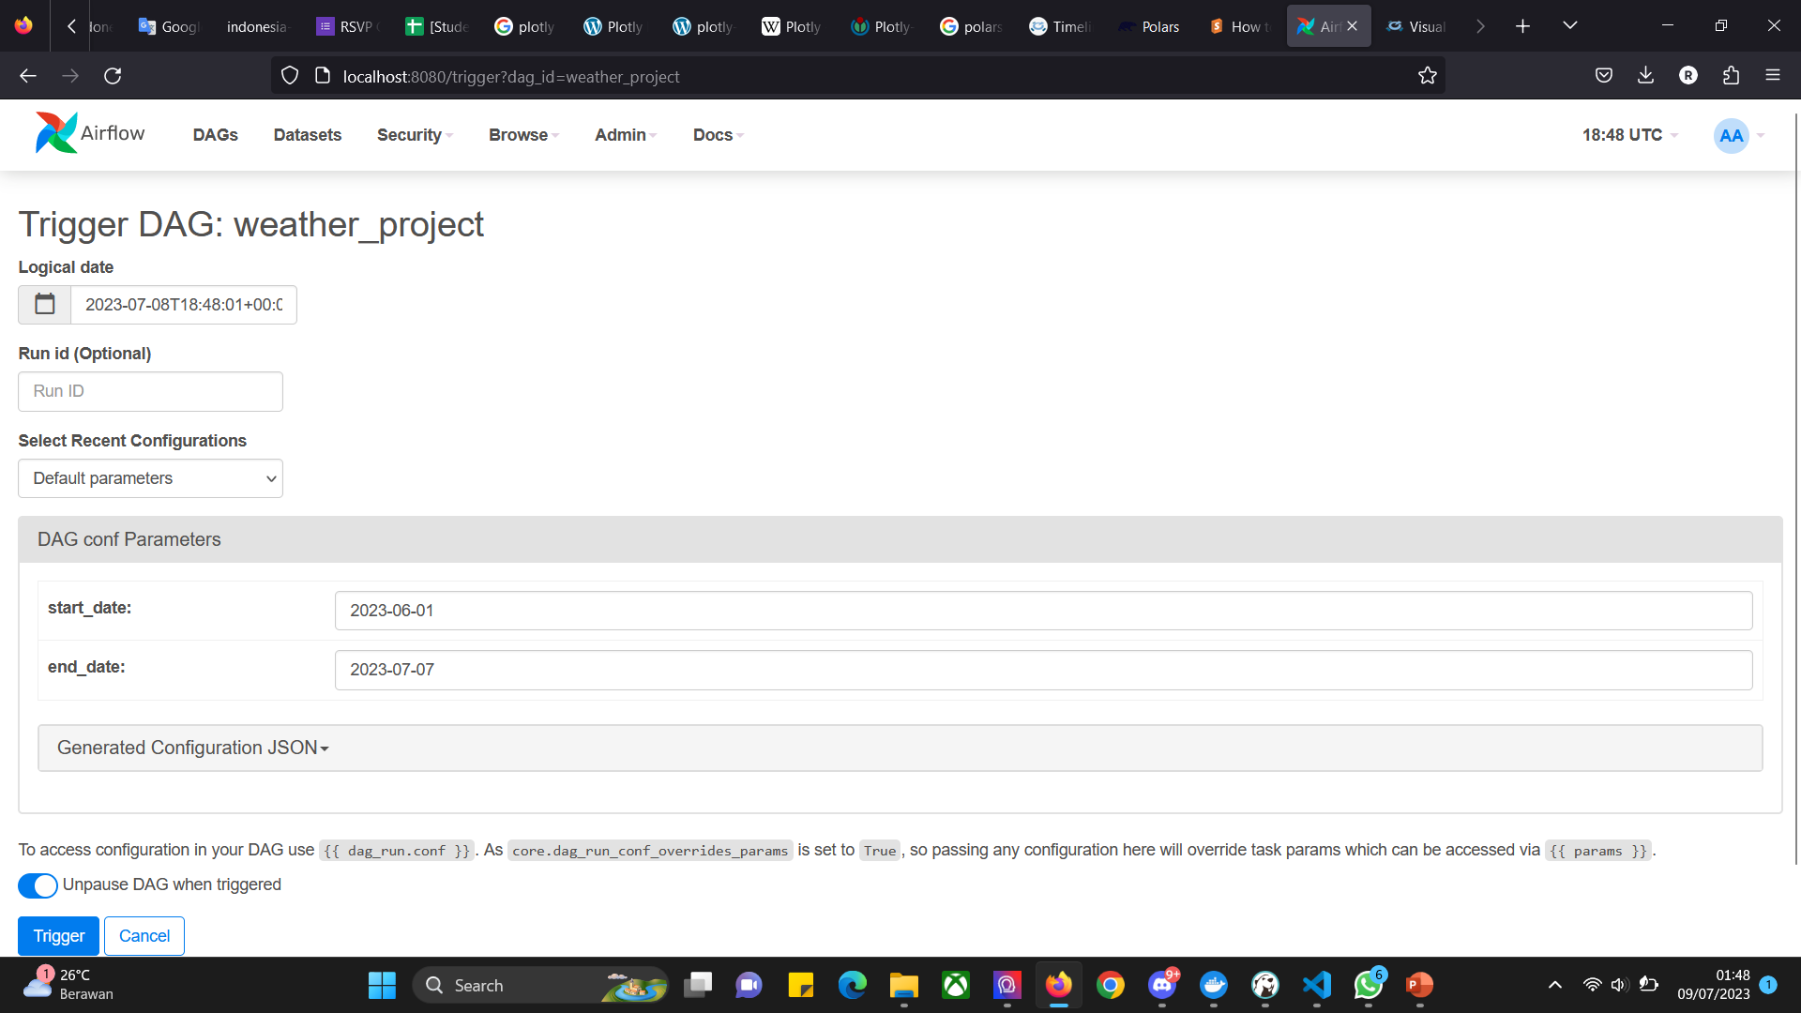
Airflow Structure
O2
Robust ETL pipline for every province in Indonesia
Save variable in variables for easy change to citys and api_key security
Idempotent code and easy parameter modification using Parameters function

Slide 7
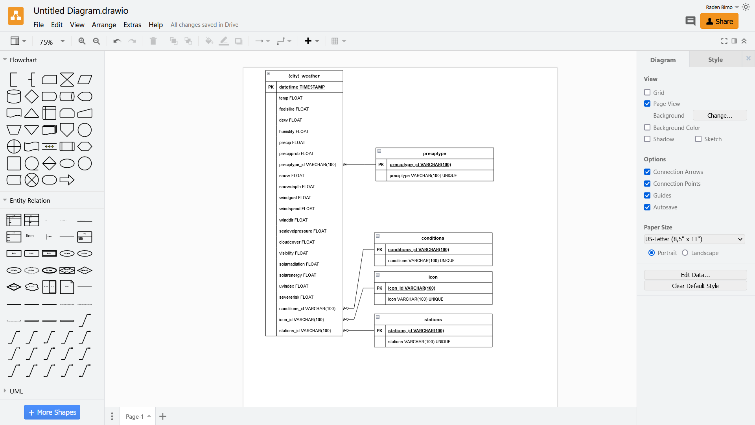
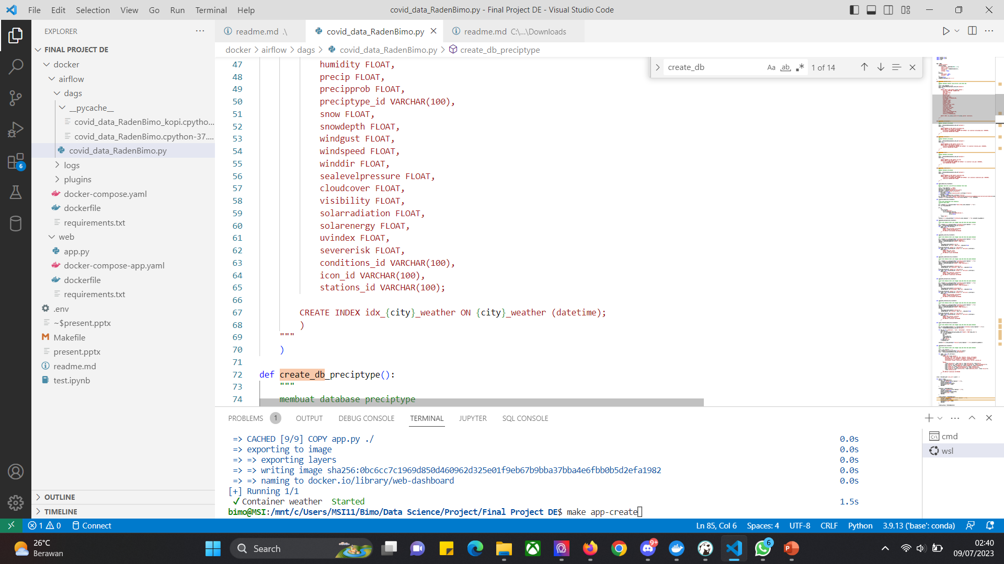
Database
O3
Each province has its own unique schema and structure for its weather database.
The weather database is designed as a time series database, while the dimension table can be joined with the weather tables of all provinces.
Every weather Database has been indexed to handle growing data.
{city}_weather

Slide 8
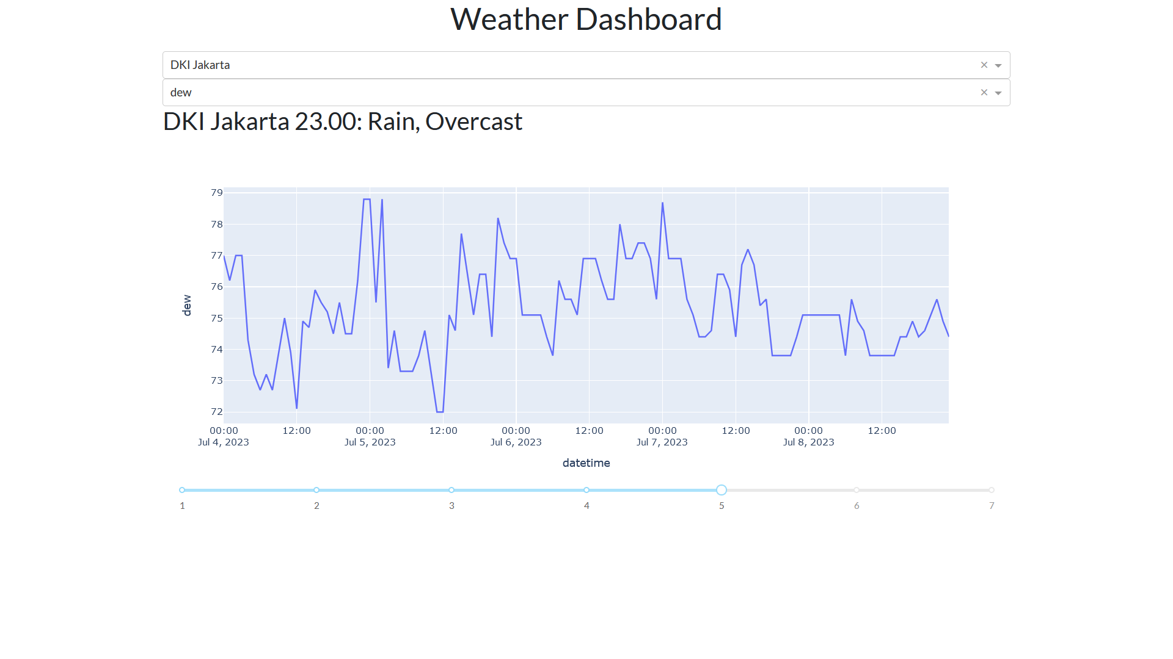
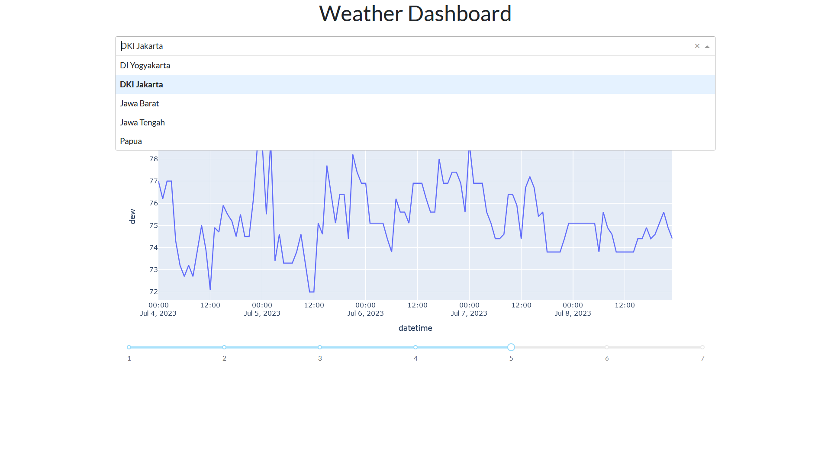
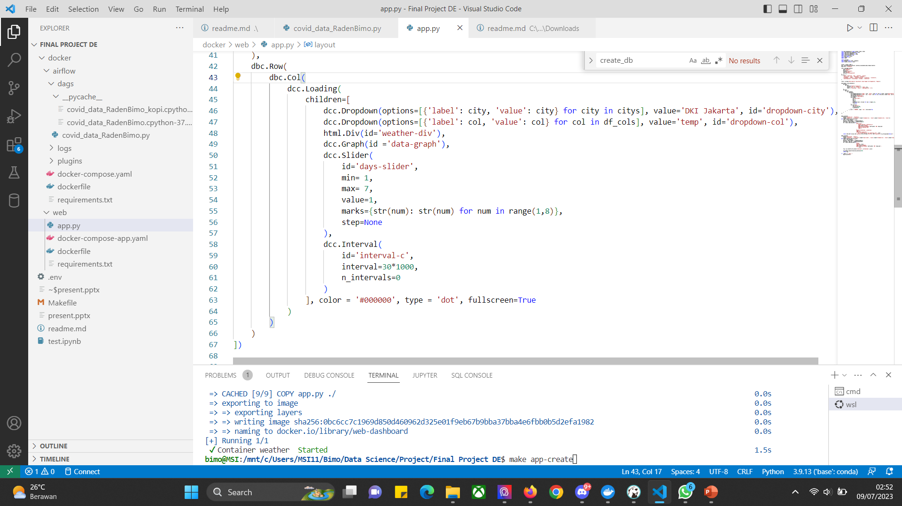
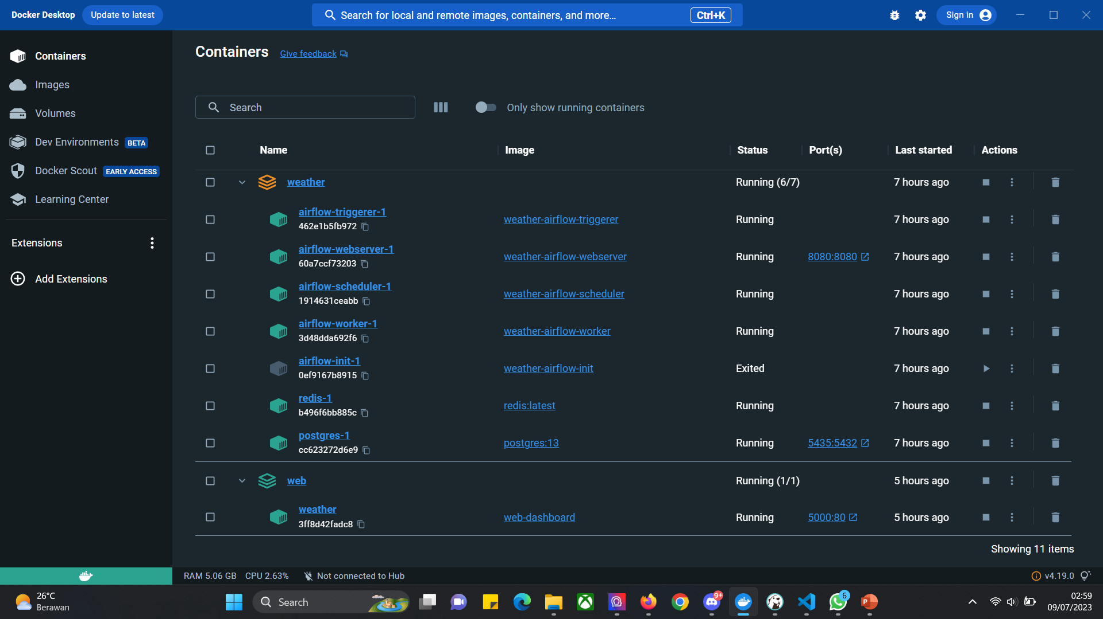
App
O4
Interactive time series graph and interactive filter such as dropdown and drag filter allowing users to explore patterns, trends, and relationships within the data.
The graph and current weather constantly get updated if data avaible.
The application is running on Docker, ensuring that it operates in the background without the risk of accidental shutdowns.

Slide 9
THANK YOU
https://www.linkedin.com/in/radenbimo/

